Slide 1
Lesson 23 – Price and Register CalHFA, CalPLUS, MyHome & Zip

Slide 2
Pricing and Registering CalHFA, CalPLUS, MyHome & Zip
Disclosure Process for CalHFA, CalPLUS, MyHome & Zip

Slide 3
Price and Register: CalHFA, CalPLUS, MyHome & Zip

Slide 4
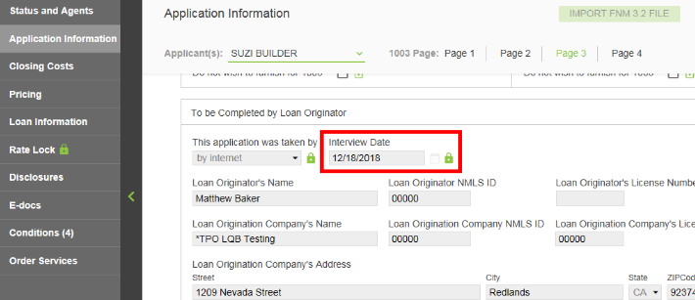
Best Practice to complete prior to pricing
00-A.
Ensure Interview Date “lock” is unlocked.

Slide 5
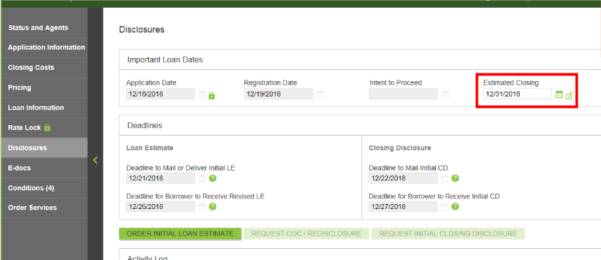
Best Practice to complete prior to pricing
00-B
In Disclosures screen, confirm Estimated Closing date is accurate

Slide 6
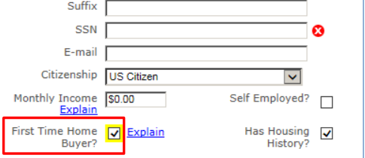
1.
In pricing screen, confirm borrower is a First Time Home Buyer

Slide 7
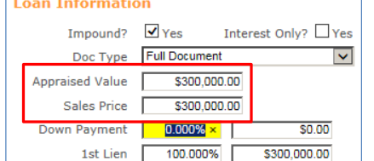
2.
In pricing screen on Property & Loan info tab, enter Appraised value and Sales Price

Slide 8
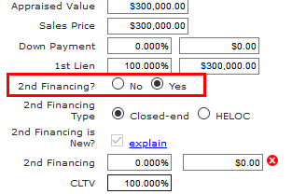
3.
Select “Yes” for 2nd Financing

Slide 9
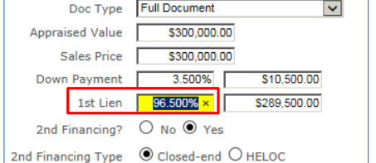
4.
Insert LTV % of the first lien

Slide 10
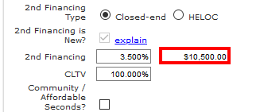
5.
Enter Loan amount for MyHome in 2nd Financing field

Slide 11
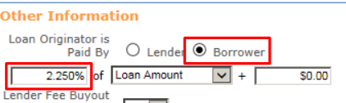
6.
Set Loan Originator to “Borrower Paid”
Enter comp percent

Slide 12
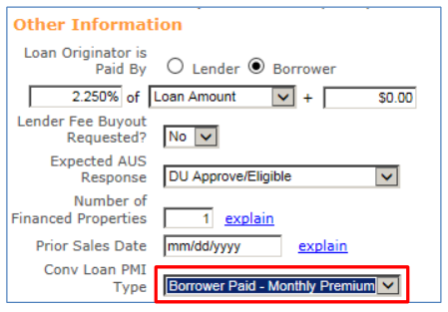
7.
To obtain Conventional programs, set the PMI Type to “Borrower Paid Monthly”

Slide 13
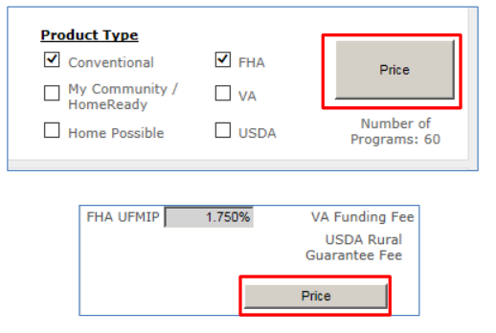
8.
Click Price (located at the top and bottom of the pricing screen)

Slide 14
9.
Select “go to 2nd lien" for the 1stCalPLUS lien program you want

Slide 15
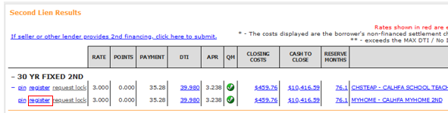
10.
When the second lien program results screen appears, select “register” for the MyHome 2ndTD program.

Slide 16
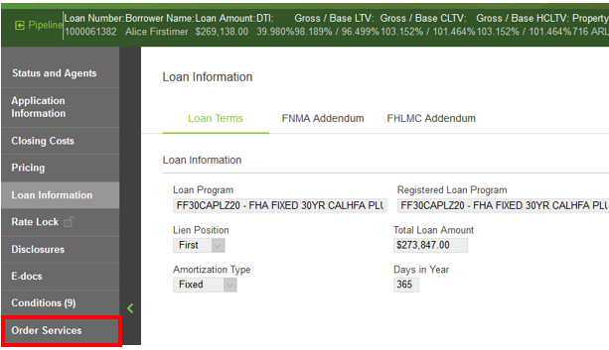
11.
Once loans are registered, proceed to the “Order Services” tab

Slide 17
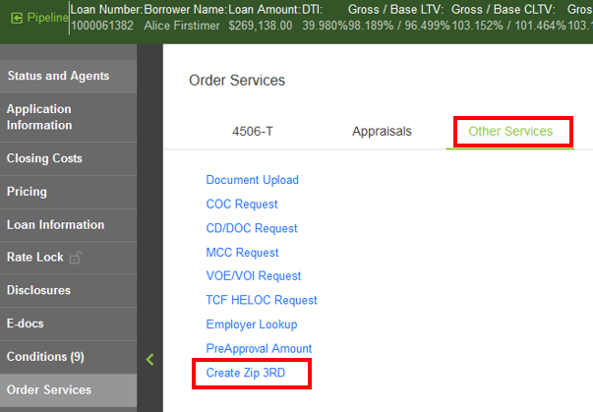
12.
Go to “Other Services” tab and click on “Create Zip 3RD”

Slide 18
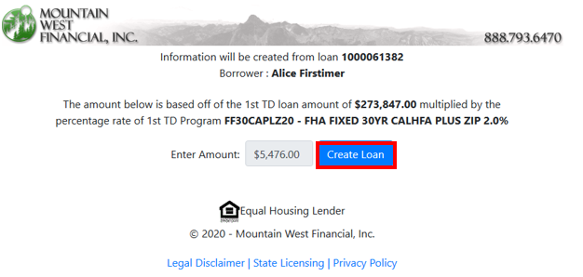
Pop up window to create Zip 3rd
13.
Confirm Zip Loan amount and click “Create Loan”

Slide 19
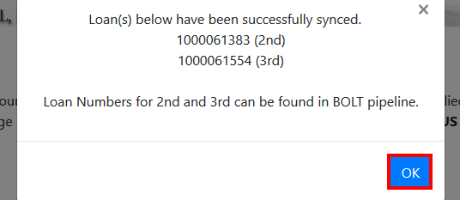
Zip 3rd has been created
14.
Click “OK” to close window

Slide 20
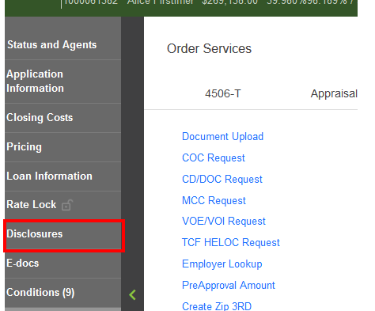
15.
Proceed to Disclosures

Slide 21
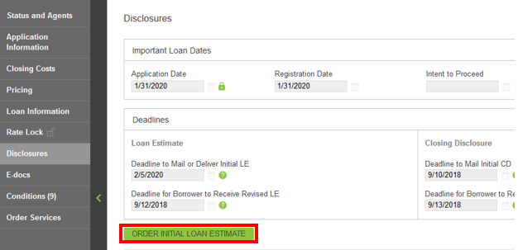
Order Initial Loan Estimate
16.
Follow Slides 7 – 18 in Lesson 14: Issuing Initial Disclosures

Slide 22
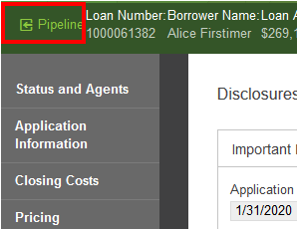
After Initial Disclosure for 1st are issued
17.
Proceed back to Pipeline

Slide 23
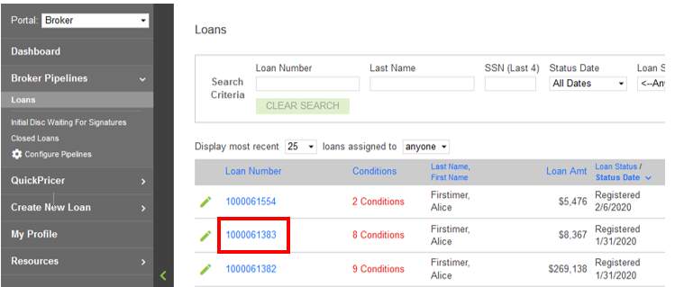
18.
Locate and Click on 2nd loan number

Slide 24
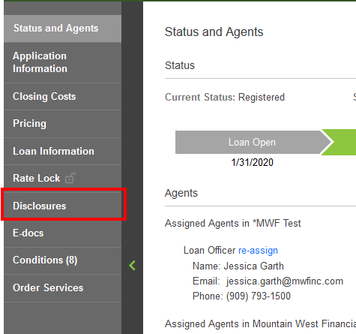
19.
Proceed to Disclosures

Slide 25
Order Initial Loan Estimate
20.
Follow Slides 7 – 18 in Lesson 14: Issuing Initial Disclosures

Slide 26
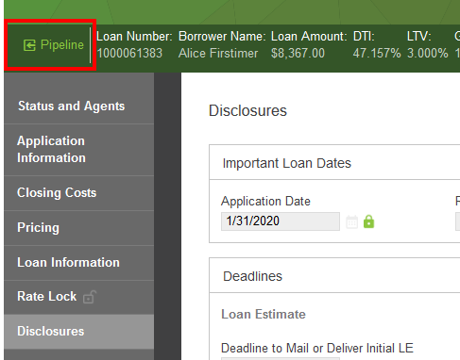
After Initial Disclosures for 2nd are issued
21.
Proceed back to Pipeline

Slide 27
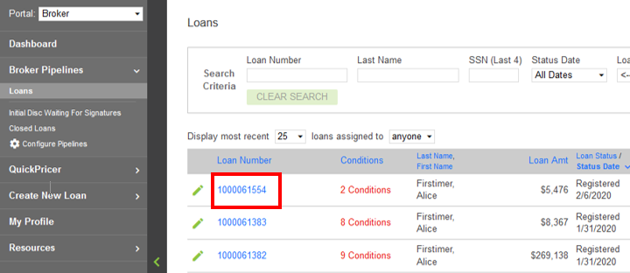
22.
Locate and Click on 3rd loan number

Slide 28
23.
Proceed to Disclosures

Slide 29
Order Initial Loan Estimate
24.
Follow Slides 7 – 18 in Lesson 14: Issuing Initial Disclosures

Slide 30
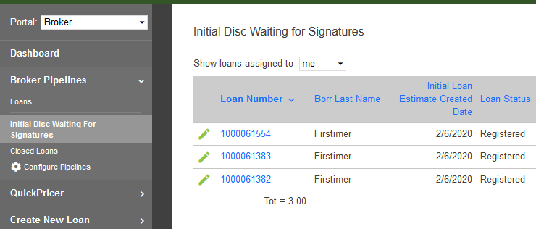
Loans waiting for Initial Disclosures
25.
You can see the 3 loans waiting for signatures in the “Initial Disc Waiting For Signatures” Pipeline

