Slide 1

The Benefits of Conventional Lending in Today’s Marketplace
Presented by: Sherrie Vaughan
Account Executive Sacramento
Sherrie.vaughan@mwfinc.com

Slide 2
Conventional Lending
Changes in the California Marketplace
Mountains of Choices
The High LTV Borrower
Conventional vs. FHA
Private Mortgage Insurance
PMI and the 3% cap
Down Payment Assistance
Product Offerings

Slide 3
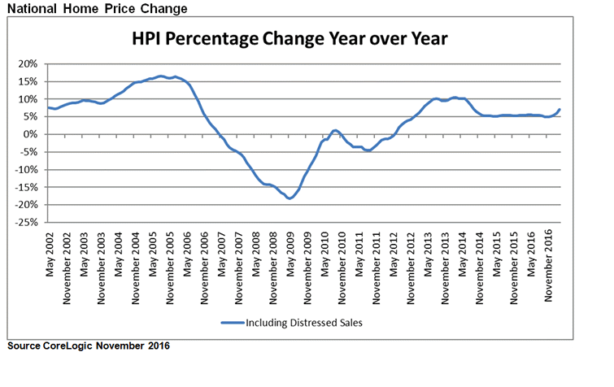
The National Market Place
Home Prices are UP!
The purchase market is here!
According to Core Logic, “National Home Prices Are Expected
to Rise 4.7% from November 2016 to November 2017.”

Slide 4
Median Home Prices Increase
Nationwide Home Values on the rise… now is the time to Buy
Median Home Value Predicted to Rise this year (per zillow)
California $485,800 2.5%
Arizona $217,600 3.8%
Colorado $321,000 4.0%
Nevada $228,900 5.1%
Oregon $297,200 4.7%
Washington $318,00 4.5%

Slide 5

Got Realtor?
Now is a GREAT time to develop realtor contacts!
Call
Visit
Use Social Media
  LinkedIn
  Facebook
  Twitter
Utilize Real Estate Links
  Redfin
  Zillow

Slide 6
Fico Trivia
DID YOU KNOW?
The Average Credit Score in the United States is currently at an all-time high of 695
Though differing scoring models exists causing fluctuation, most scores fall between 660 to 720
Credit scores typically break down in the following manner:
720 or more: Excellent
660 - 719: Average/Fair
620 - 659: Poor
620 or lower: Bad

Slide 7

Todays Product Choices
Mountains of Choices…
  Conventional DU and LP
  DU Refi Plus
  High Balance and LP Super Conforming
  True Jumbo
  Government Loans – FHA/VA
  HomeStyle
  HomeReady
  Strategic Products (DAP)
  USDA

Slide 8
FHA and the High LTV Borrower
FHA lowered Annual MIP – great news for Homebuyers!
Decrease to FHA Annual MIP – effective for case numbers assigned on or after 1/26/15
  Loans originated with terms > 15 years and amounts ≤ $625,500
    >95% LTVs decrease from 1.35% to .85%
    ≤ 95% LTVs decrease from 1.30% to .80%
  Revision to the period for assessing Annual MIP – still in effect as of 6/3/2013
    Loans originated with terms > 15 years
    >95% LTVs – Annual MIP is non-cancellable
    ≤ 95% LTVs – Annual MIP is cancellable at the end of the mortgage term of for the first 11 years, whichever comes first

Slide 9

Conventional offers PMI Choices
FHA is not the only High LTV option.
Private Mortgage Insurance offers choices for High LTV borrowers!
Mountain West Financial’s PMI Partners:
  MGIC www.mgic.com
  Radian www.radian.biz
  Genworth www.mortgageinsurance.genworth.com

Slide 10
PMI Shines…Conforming
For an LTV > 95%, FHA is a great option for lower fico scores
But at 95% LTV for Conforming loans and 95% for High Balance
PMI shines for higher fico scores
Conventional Conforming:
95% LTV OO - Purchase and R/T - 620 FICO
  (SFR, Condo, PUD - Manufactured)
  90% LTV Second home- Purchase and R/T - 620 FICO
  (SFR, Condo, PUD - Manufactured)
  85% LTV NOO – Purchase - 620 FICO
  (SFR, Condo, PUD

Slide 11
PMI Shines… High Balance
High Balance and *LP Super Conforming
95% LTV – OO Purchase R/T – 620 FICO
(SFR, Condo *Du Only, PUD) *LP does not allow Condo
90% LTV – Second Home Purchase R/T – 620 FICO
(SFR, Condo, PUD)
85% LTV – Investment Purchase – 620 FICO
(SFR, Condo, PUD)

Slide 12
PMI offers Options
  Borrower Paid MI (BPMI) – borrower pays monthly
    Can be refundable or non-refundable
    MI payment may be lower than FHA
  Lender Paid MI (LPMI) – no monthly payment
    MI factored into the rate
  Split Premium – (SPMI) Reduced monthly MI payment
    Paid up-front and paid monthly (cannot be financed)
    Can be paid by Seller or Lender Credit (or combination of both)

Slide 13
PMI can go away!
The best part about PMI?
It can go away!

Slide 14
PMI Termination ☺
Automatic Cancellation:
When the LTV reaches 78% or Original Value
Payments are current
Borrower Initiated Cancellation:
When the LTV ratio is 80% or less or Original Value
  Zero x 30 in 12 months and Zero x 60 in 24 months
  Servicer orders appraisal to certify value
  (depending on MI Company, may require 5 year seasoning

Slide 15
PMI and the 3% cap
Monthly Premium
  Will NOT be included in the points and fees calculation
BPMI Non-Refundable
  The entire upfront premium amount will be included, regardless if it is paid by the borrower, financed into the loan, or paid with a seller or builder credit.
BPMI Refundable
  The upfront premium amount in EXCESS of FHA’s upfront premium will be included, regardless if it is paid by the borrower, financed into the loan, or paid with seller or builder credit.

Slide 16
Compare PMI to FHA
$300,000 Purchase w/ 5% Down Payment & BPMI
FICO | FHA- 620 | PMI - 760 | PMI - 720 | PMI- 620
Rate | 4.250% | 4.25% | 4.375% | 5.00%
Base Loan Amount | $285,000 | $285,000 | $285,000 | $285,000
UFMIP | 4,988 | $0 | $0 | $0
Total Loan amount | $298,988 | $285,000 | $285,000 | $285,000
Monthly MI | $189 | $97 | $173 | $382
PITI | $2011 | $1895 | $1992 | $2308
Est. MI Cancel (assume 5% ann. Appr) | Can not Cancel | 3.7 | 3.7 | 3.7

Slide 17
LPMI
FICO | FHA- 620 | PMI - 760 | PMI - 720 | PMI -620
Rate | 4.250% | 4.75% | 5.00% | 5.5%
Base Loan Amount | $285,000 | $285,000 | $285,000 | $285,000
UFMIP | 4,988 | $0 | $0 | $0
Total Loan amount | $298,988 | $285,000 | $285,000 | $285,000
Monthly MI | $189 | $0 | $0 | $0
PITI | $2011 | $1861 | $1925 | $2013
Pricing Cost |  |  |  | 2.745

Slide 18
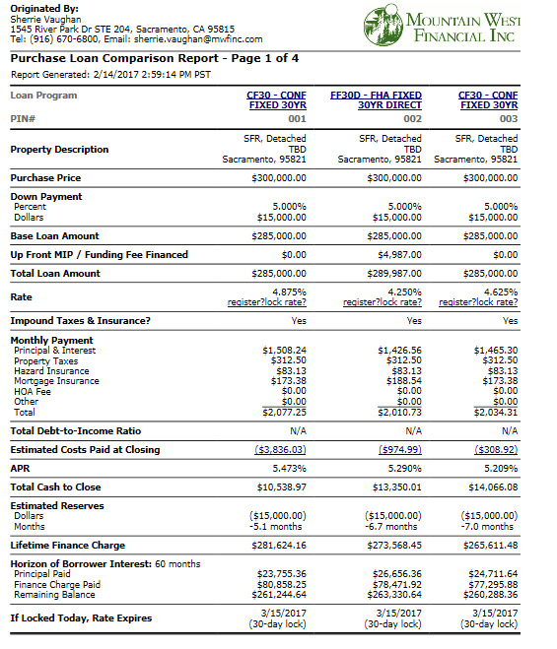
Let “Price my Loan” do it for you (login with your credentials in BOLT…www.mwfinc.com)

Slide 19

PMI Tools
All of the PMI websites offer tools!
PMI Rate Sheets/Grids
Rate Comparison Tools
Marketing Materials
Recorded Webinars
First Time Home Buyer Seminars

Slide 20
Conventional >95%?
Program CF30
Only one borrower needs to be a First-Time Home Buyer
Purchase R/T - DU
SFR/Condo/PUD
$424,100 max loan amount
1 unit
FICO
620
Gifts ok
Reserves
Per AUS

Slide 21
HomeReady
Designed for creditworthy, low-to-moderate income borrowers, with expanded eligibility for financing homes in designated low-income, minority and disaster impacted communities. Homestyle renovation is ineligble
97% LTV 105% CLTV (cltv with MWF approved community second)
Purchase R/T
620 FICO
SFR/Condo/PUD
$424,100 Maximum Loan Amount
Homebuyer Education required on Purchases
Must meet income limits per Fannie Mae (AMI)
Gifts ok
Reserves
Per AUS

Slide 22
Conventional + DPA
Down Payment Assistance is not just for FHA!
Several programs can be added to Conventional loans and even combined!
CalHFA ECTP
CalHFA My Home
CalHFA + Zip
GSFA
**Don’t forget MCC’s (Mortgage Credit Certificate) which can help borrower’s qualify and get a Tax Credit
To name a few…..
For the entire list go to: www.mwfinc.com
Click on Affordable Housing tab under Quick Links

Slide 23

Time and Place
It is a Purchase Market in 2017. Explore all your options for your Borrowers - Conventional, High Balance, FHA, VA, USDA, CalHFA. Whatever your needs are for financing:
Mountain West Financial, Inc. has the solution!
Product Variety
PMI choices for high LTV Borrowers
  With Lower MI costs
Down Payment Assistance Options

Slide 24

Thank You!
Thank you for attending today’s presentation!
Contact your Account Executive to strategize the best options for your borrowers.
Let’s close some loans together!

